Slide 1
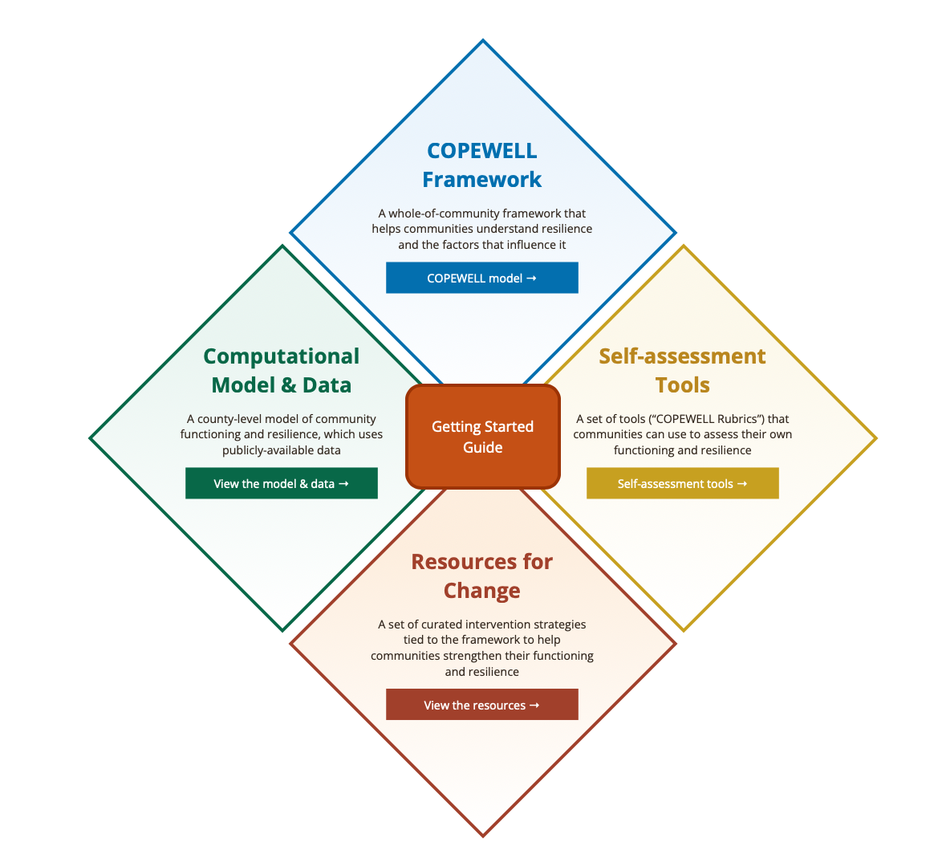
COPEWELL:
Grounding Our Work In Practice
https://www.copewellmodel.org

Slide 2
COPEWELL Goals
Provide communities ways to collectively:
Understand resilience and its influencers
Assess community resilience
Spark action for further development
Goal
Systems dynamic model
Scoring rubric for local self-assessment (“bottom-up”);
Comparative county metrics using national data (“top-down”)
Facilitation guides for community dialogues
Resource

Slide 3

COPEWELL
Informed by practitioners
Guided by experience with communities

Slide 4
Grounding COPEWELL in Practice
Involved those with field experience in model development
Fielded early model / held focus groups with:
  Federal Partners
  Field Practitioners: Across geographies and sectors
Implementation Explorations
  New York City
  Chester County (PA)
  Twin Ports (MN)
  6+ additional jurisdictions, 2020-2022

Slide 5
What has field input led to or changed?
Development of Community Self Assessment Rubrics
Curated Resources
Development of Idea Triggers – e.g., mapping to use in meeting PHEP HVA requirements
Website – Getting Started Guide; Videos, Displays, etc.

Slide 6
Things learned in measuring & advancing resilience…
Things We’ve Learned
Be scalable (e.g., geoscale, domain, resources, etc.)
Resilience can be modeled but is nuanced locally. Systems interact and can be complex. It’s about more than the numbers.
Usefulness of BOTH standardized data and community self-knowledge / wisdom
Advancing resiliency involves engaging across sectors in ways that are constructive, creative, non-judgmental.
Curated resources to spark action ideas are useful.
Progress is driven by relationships, trust, shared vision.
Facilitation / local leadership and support is important.
COPEWELL offers opportunity to advance everyday Community Functioning as well as Disaster Resiliency (the two interrelate)

Slide 7
What Communities are Using COPEWELL for
Helping leaders & partners “get their arms around” what disaster resilience is and “see” themselves in it.
Funding / grant applications; Targeting resources and support (model output, indicator data)
Driving cross jurisdictional discussions; Encouraging regional approaches.
Undertaking Disaster Resiliency Self Assessments (single / multiple domain) with a goal of building relationship & sparking action.
Engagement of non-traditional partners in resiliency building efforts
Strategic Planning around Community Functioning
Building political support for needed community initiatives (e.g., put efforts in broader context)
Advancing VOAD/COAD development

Slide 8
Methods of Use (examples)
Website and Tool Exploration
Model Exploration – Conceptual and Computational
Map/data use (stand alone or in context of neighbors)
Development of a pre-meeting survey / assessment
Single episode workshop among partners
Series of meetings with partners
Integration of tools with other planning resources / tools.

Slide 9
Flexibility / Adaptability to Local Needs
Jurisdictions use COPEWELL differently, as to:
  Who Leads: City / County Gov’t; Emergency Management (State, Regional); Public Health; State VOAD
  Who Supports/Facilitates: Contractor; Academic Partner; In House staff
  Partners engaged: Council of Governments, Emergency Management, COADs, Public Health, Social Service Agencies, Healthcare System, Multi Sector collaboratives, etc.
  How being used: Support grant applications; Encourage local / regional use; engage partners; advance COADs; Identify priority resiliency initiatives; inform / structure community surveys
Notes:
Who engaged varies with domain being addressed / desired outcomes

Slide 10
Outcomes Reported from Communities:
  Stronger community understanding of resiliency and how to build it
  Stronger partnerships / engagement / relationships
  New resiliency-related interventions
  Political and financial support for identified initiatives
  Engagement / planning around Community Functioning / SDOH (transport, housing, broadband, etc.)
  Integration of resiliency related indicators into local data collection systems
  Other…..
Notes:
New partnerships resulting from –
--ability to discuss resiliency in a less politically charged environment;
--partners typically not engaged in preparedness or disaster response see themselves in the work (behavioral health, etc.)

